Slide 1

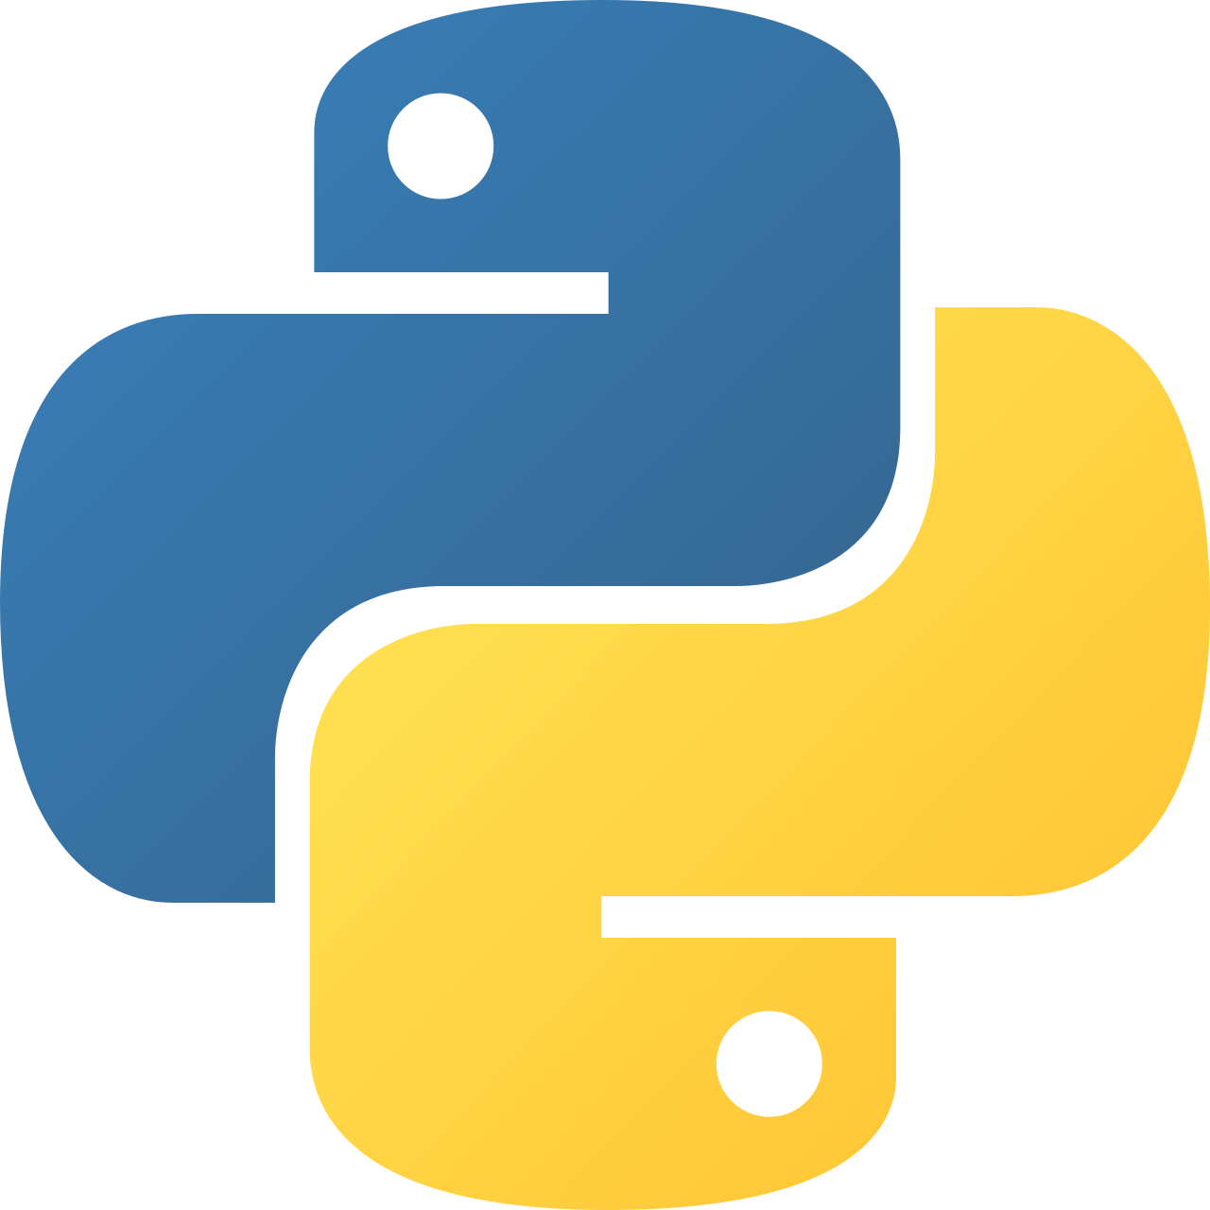
Intermediate Python
pip and venv

Slide 2
pip: Python Package Manager
pip installs and manages external Python libraries from PyPI.
pip installs third-party packages (e.g., pandas, numpy, requests)
Packages are downloaded from PyPI (Python Package Index)
Use python -m pip for version-safe execution
Can install specific versions (package==1.2.3)
Supports dependency management automatically
Generates reproducible environments with requirements.txt
Notes:
Explain that pip:
Is the standard Python package manager
Automatically installs dependencies
Should be used with python -m pip to avoid version mismatch
Is required before using libraries like Pandas or NumPy

Slide 3
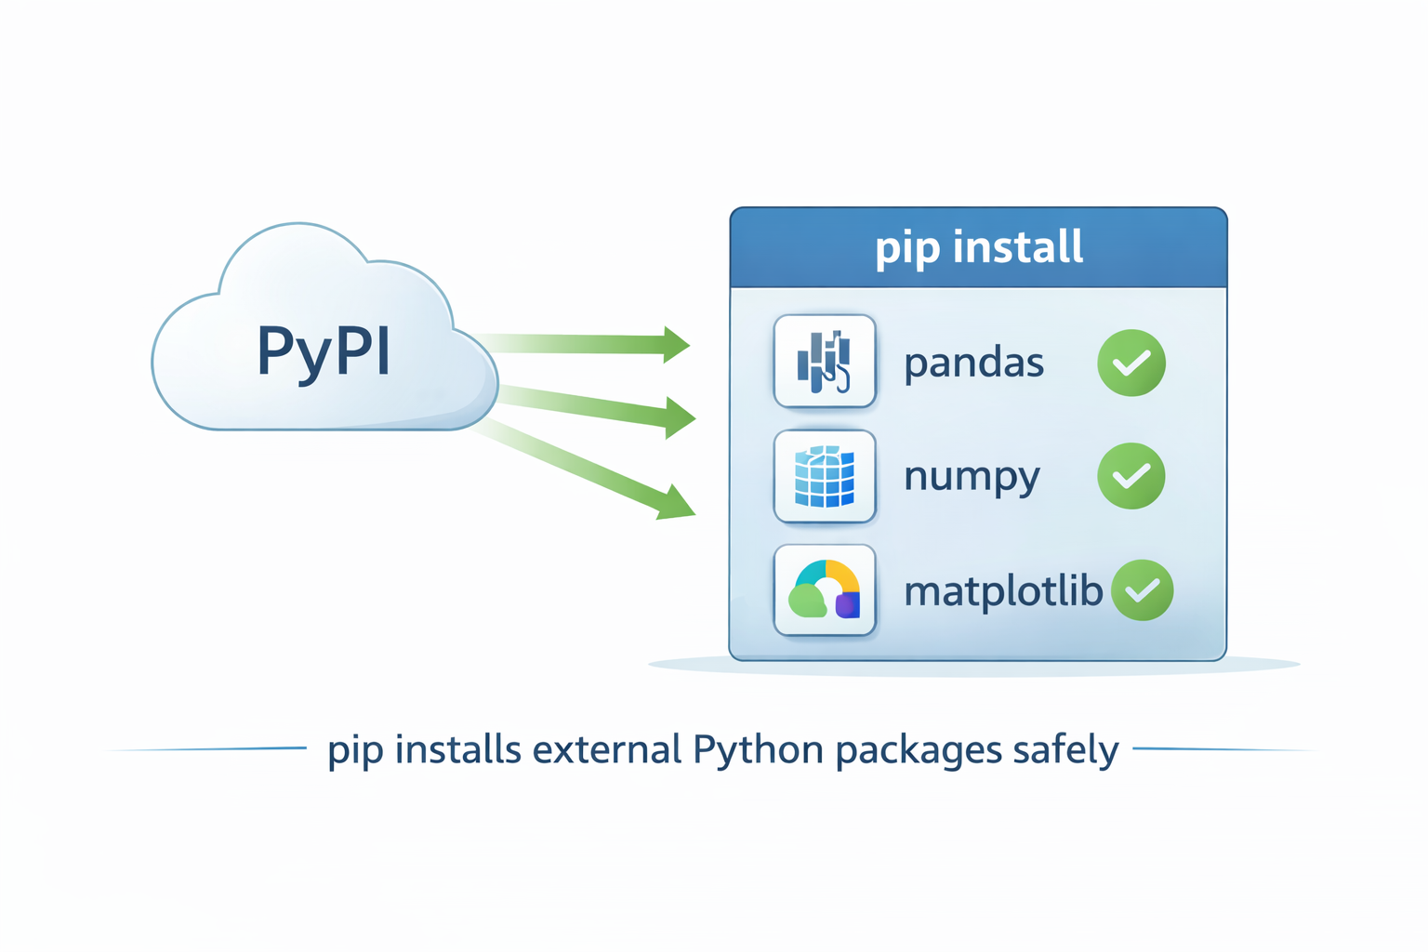
Example Commands
python -m pip install pandas
python -m pip install numpy==1.26.0
python -m pip freeze > requirements.txt

Slide 4
Virtual Environments (venv)
venv creates isolated Python environments to prevent dependency conflicts.
Each project should have its own environment
Prevents package version conflicts
Keeps global Python installation clean
Allows reproducible development setup
Works together with pip
Essential for professional projects
Notes:
Explain:
Without venv → all projects share one global environment
Conflicts occur when different projects need different package versions
venv isolates dependencies per project
Always activate venv before installing packages

Slide 5
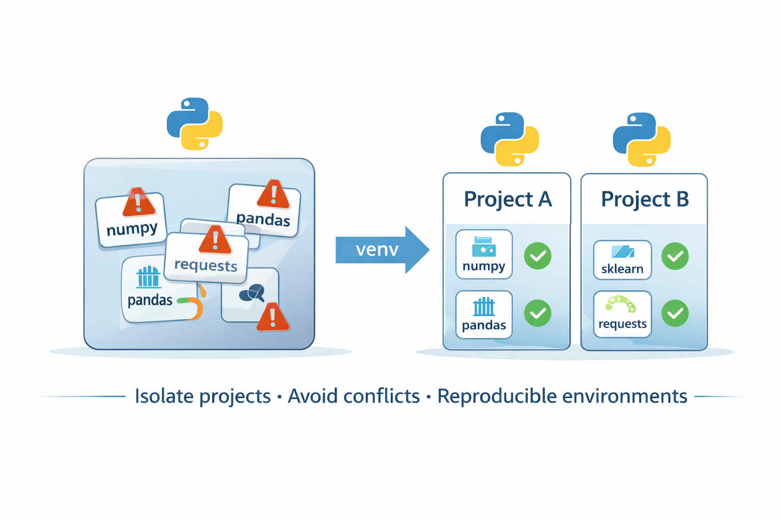
Sample command
python -m venv venv
source venv/bin/activate # Mac/Linux
venv\Scripts\activate # Windows
pip install pandas

